Slide 1





Financial Analysis of different States
By
Ananya Rakesh
Tools used-

Slide 2
IMPortant FinanciAl TerMs
Expenditures
Deficits & GDP
Taxes
Revenue Expenditure – That government expenditure does not lead to the creation of fixed assets called revenue Expenditure.
Capital Expenditure – The money spent by the government on the various development activities
Aggregate Expenditure – Expenditure made by the government in the economy
Social Sector Expenditure- the expending of the government on the welfare of the people
Revenue Deficit - it is the excess of its total revenue expenditure to its total revenue receipts.
Gross Fiscal Deficit – The Excess of total (Revenue & Capital) expenditure over total rev & cap)receipts excluding borrowing is called a fiscal deficit.
GDP(Gross Domestic Product)Goods and Services which are created inside the boundary of the State
Own Tax Revenue – it is the collection of taxes that are collected by states.

Slide 3
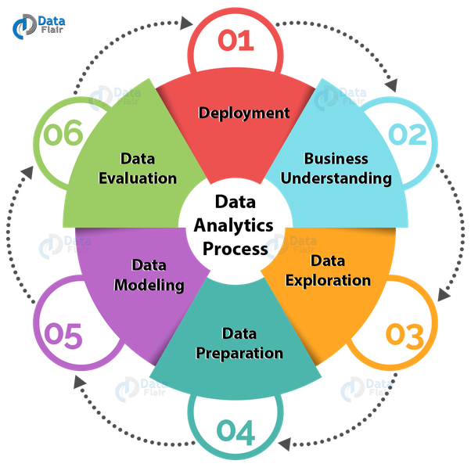
Problem STATEmENT Analyze the Financial Statistics of the States On the basis of a 5-year Interval and Find out some important information And KPIs From it

Slide 4
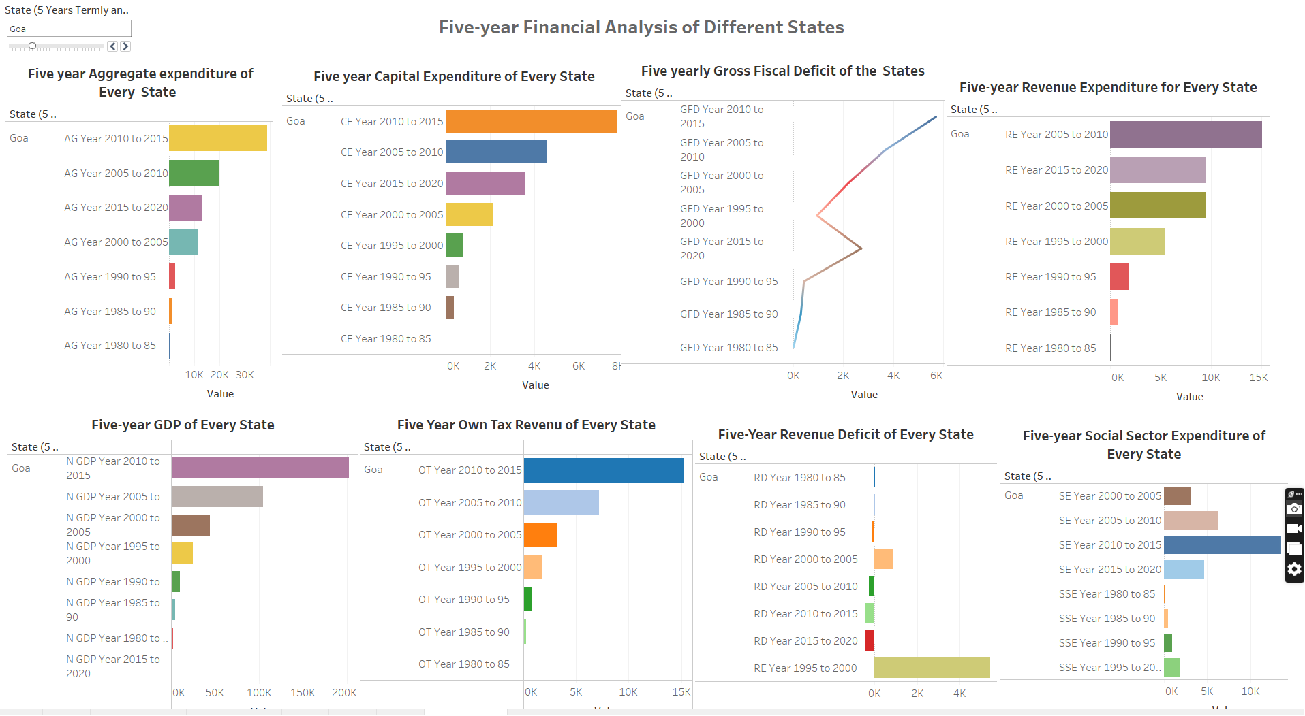
Financial Analysis of Different States in terms of Five Years
In this analysis, we are comparing financials like Aggregate expenditure,
Capital expenditure, Gross Fiscal Deficits, Nominal GDP, Own tax revenue, Social sector expenditure, Revenue Deficits, and Revenue expenditure on the basis of five years.

Slide 5
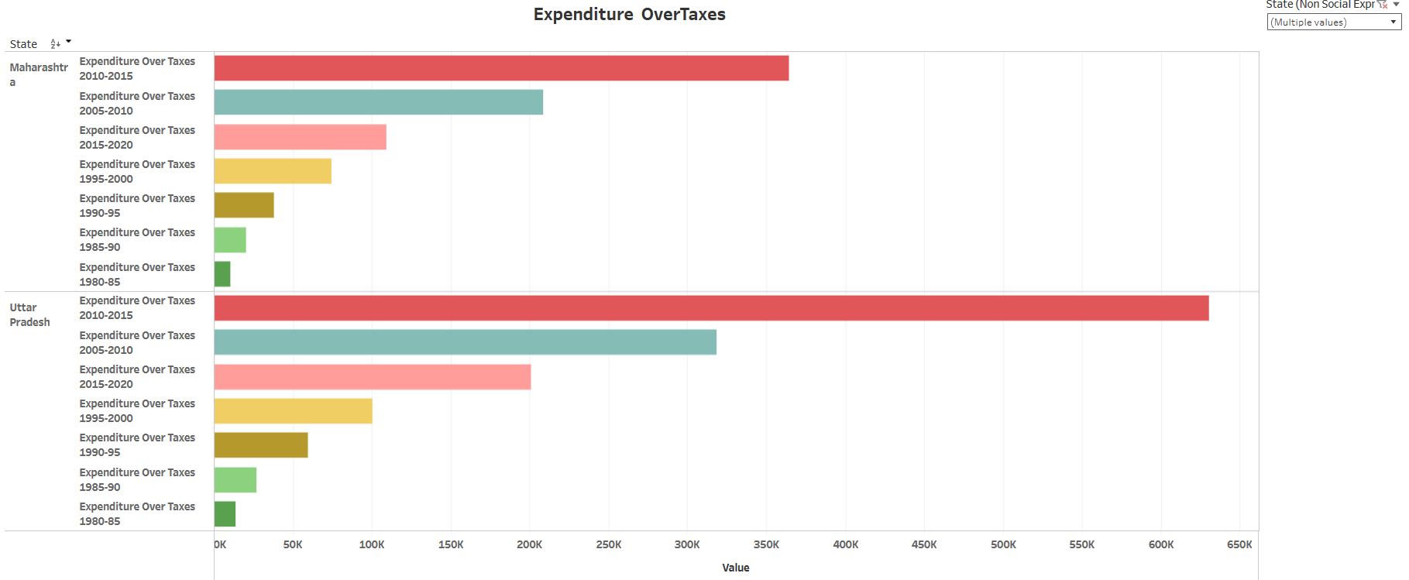
Expenditure over taxes From this data, we found that taxes which come from various source are not sufficient for the expenditure of the government and the government need more sources of income
If taxes from various sources are not sufficient to cover the government's expenditures, there are several potential options to explore for increasing income. Here are a few suggestions:
Increase tax rates: The government can consider raising tax rates on certain income brackets or industries to generate additional revenue.
Expand the tax base: The government can review and potentially broaden the tax base by including more individuals or businesses in the tax system.
Privatization and public-private partnerships: The government can consider privatizing certain assets or entering into public-private partnerships to generate income.
Foreign direct investment: The government can actively attract foreign direct investment (FDI) by offering incentives and creating a favorable investment climate.

Slide 6
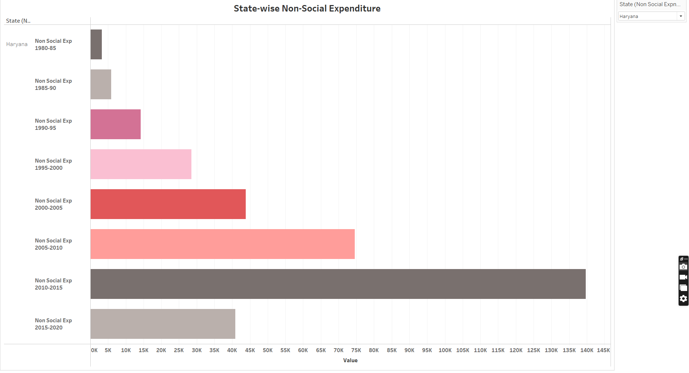
Aggregate Expenditure-Social sector Expenditure
This data will help to understand what part of the Total or Aggregate Expenditure the Government Expending on the well fare of the State.

Slide 7
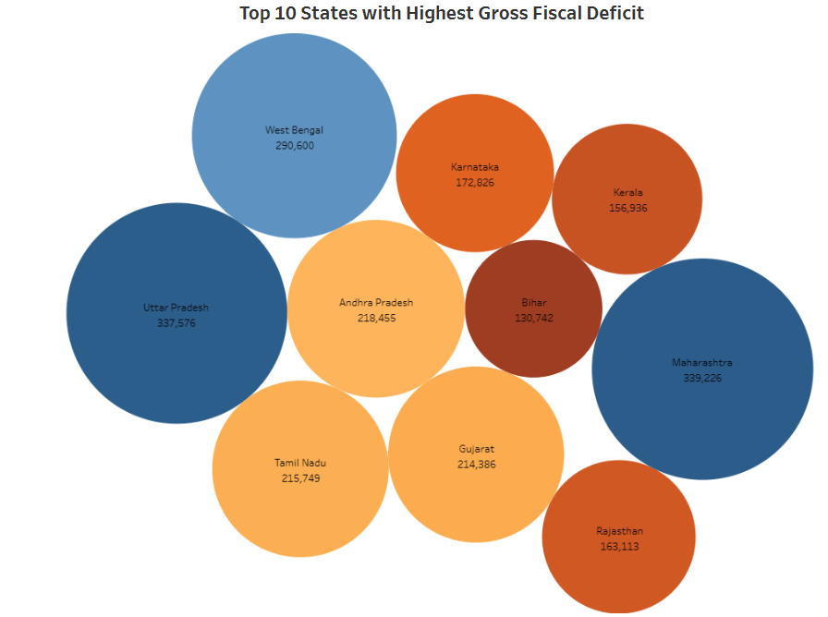
TOP 10 STATES WITH HIGHEST GROSS Fiscal DEFICITS
Reasons behind high fiscal deficit
High Expenditure: States with high fiscal deficits often have high expenditures on various fronts, such as infrastructure development, social welfare programs, education, healthcare, and public services.
Revenue Shortfall: States heavily depend on revenue from various sources, including taxes, fees, grants, and central government transfers.
Subsidies and Debt Servicing: Some states provide subsidies for essential goods like food, fuel, and electricity.
Economic Slowdown: Economic downturns or sluggish growth can lead to reduced tax collections, lower business activity, and increased unemployment.
Infrastructure Investments: States that undertake large-scale infrastructure projects may initially experience higher fiscal deficits due to the substantial upfront costs.

Slide 8
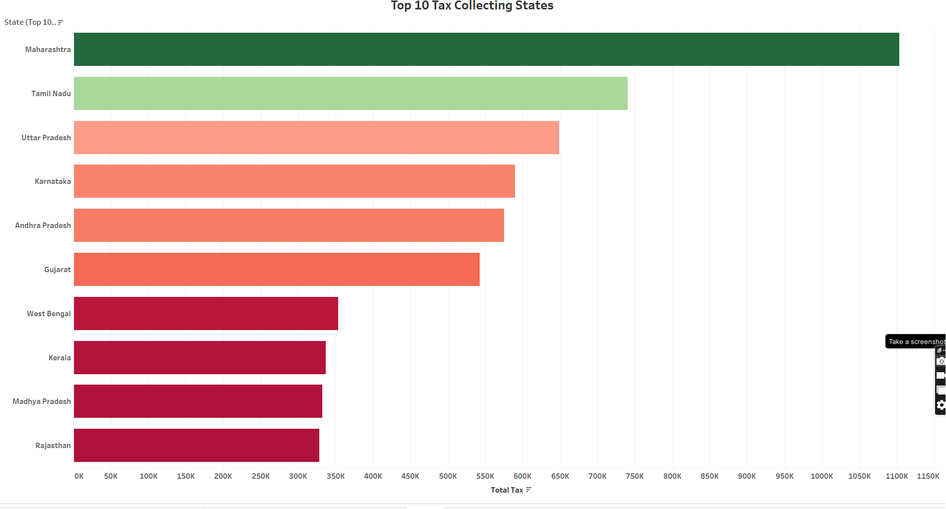
Top 10 tax-collecting States
The state of Maharashtra collects maximum taxes reasons behind it
Economic Growth: The tax collection of a state is often linked to its economic growth. When the economy expands, business activity increases, leading to higher tax revenues.
Tax Policy and Administration: The effectiveness of tax policies and administration also plays a role in tax collection. States with well-designed tax policies, efficient tax collection systems, and robust tax compliance mechanisms are likely to have higher tax collections.
Sectoral Contributions: Different sectors of the economy contribute differently to tax collections. For example, manufacturing, services, and real estate sectors can have a significant impact on tax revenues.
Tax Compliance: Tax compliance, including the extent to which taxpayers fulfill their tax obligations, is crucial for tax collection.

Slide 9
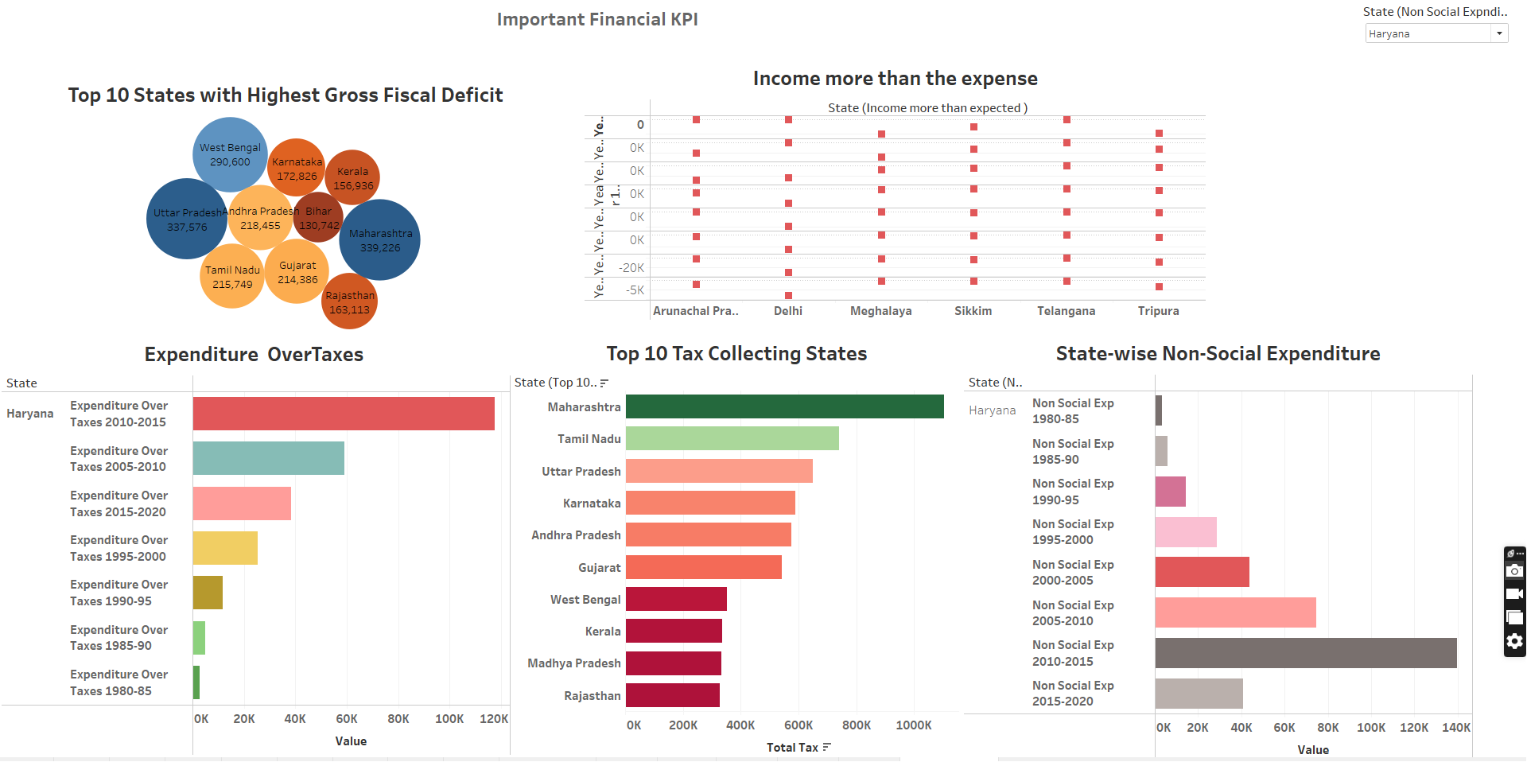

Slide 10
Conclusion
The Financial Analysis of various Indian State (individual) data Analytics projects has several financial implications for policymakers, investors, and other stakeholders. Some of these implications include:
Improved resource allocation: By analyzing the financial data of various Indian states, this project can help policymakers and investors identify which states have strong financial resources and which ones require additional funding.
Better investment decisions: Investors can use the financial data of Indian states to make better investment decisions. By analyzing the financial health of different states, investors can identify which ones are likely to experience economic growth and which ones may face challenges.
Enhanced risk management: Financial institutions can also benefit from the Financial Analysis of various Indian States’ Data Analytics projects. By analyzing the financial data of different states, lenders can identify potential risks and adjust their lending practices accordingly.
Enhanced transparency: Finally, the Financial Analysis of various Indian States’ data Analytics projects can help to improve transparency in government finances. By analyzing financial data and making it publicly available, the project can help to increase accountability and ensure that government finances are being managed in a responsible and transparent manner.

Slide 11
Thank you Everyone

